Slide 1
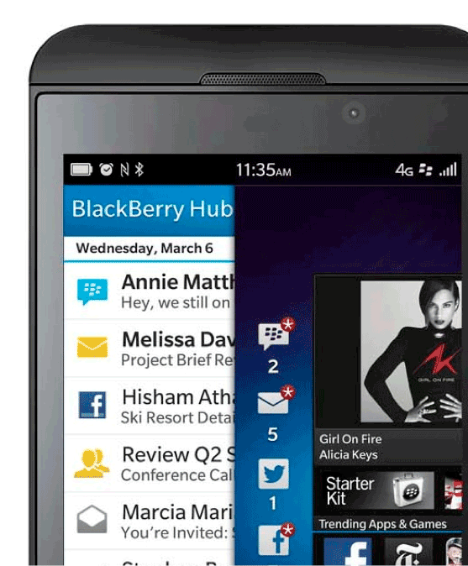
Mobile Trends and Opportunities –
A BlackBerry Perspective
Alan Wong – alawong@rim.com
@alanhhwong
Developer Relations

Slide 2
Mobile Trends in Hong Kong
Notes:
Before we look into introducing a product into a market, it is the responsibility of BlackBerry to look into the mobile trends in the respective markets, and cater to the needs and demands of the consumers. As a company constantly innovating, we realise the need to understand the trends of our consumers, YOUR consumers.
We have taken much effort looking into the trends in the past year and will continue to extend our research as we introduce BlackBerry 10 to Asia Pacific.
Looking at Indonesia, we saw some key trends in 2012, that will help us tremendously in making BlackBerry 10 the no. 1 smartphone choice in one of our top markets in the world.
Today, I would like to share some of those trends with you.

Slide 3
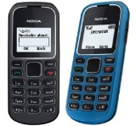
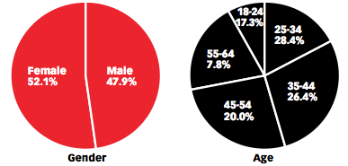
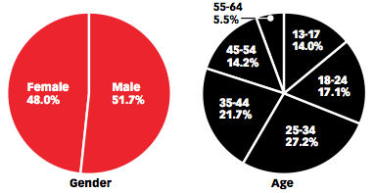
Mobile Phone Penetration
229.3%
As of February 2013
Total Population 7.1 Million
52%
48%
Smartphone Penetration
90.3%
among mobile phone owners
as of Q1 2013
Source: Nielsen BlackBoard Dashboard
Source: Nielsen Smartphone Insights
Notes:
Just for indonesia alone, we know the key demographics relating to our target audience when it comes to buying our BlackBerry smartphones.
Before we deep dive into BlackBerry user behaviour, let me give you an overview of what the Indonesian market looks like:
Total Population @ 248.6 Mil, median age: 28.5
Mobile Phone penetration @ 62%, Smartphone penetration 18% → huge opportunity for smartphone industry and the entire ecosystem there
We know what consumers are buying, and how that has changed year on year. From the chart, you can see the decrease in Nokia’s buyer’s preference, and the increasing preference for Samsung smartphone over 2012. BlackBerry, however, has remained the choice of smartphone for 44% of smartphone buyers, making us still the no. one smartphone choice in Indonesia.
We also know preference of form factor is increasingly towards Touch devices.

Slide 4
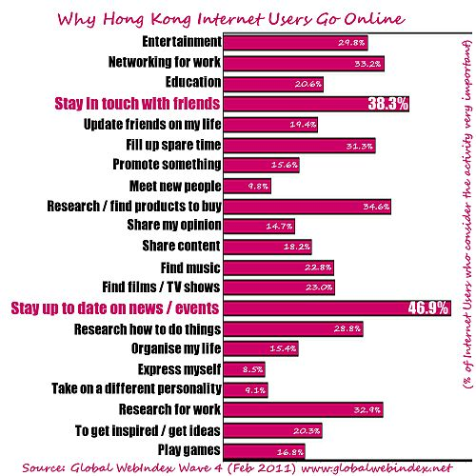
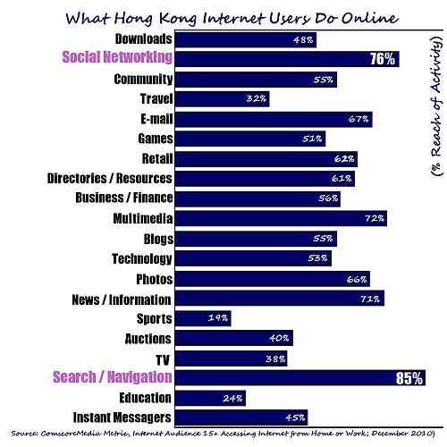
Notes:
BlackBerry users –
more affluent (credit card / car / travel),
more social (Café visits),
more visits to malls (higher exposure to trends),
requires more mobility (higher travel patterns)

Slide 6
BlackBerry –
Innovating with the trends
Notes:
With our findings in mind, our innovation need to move with the trends.

Slide 7
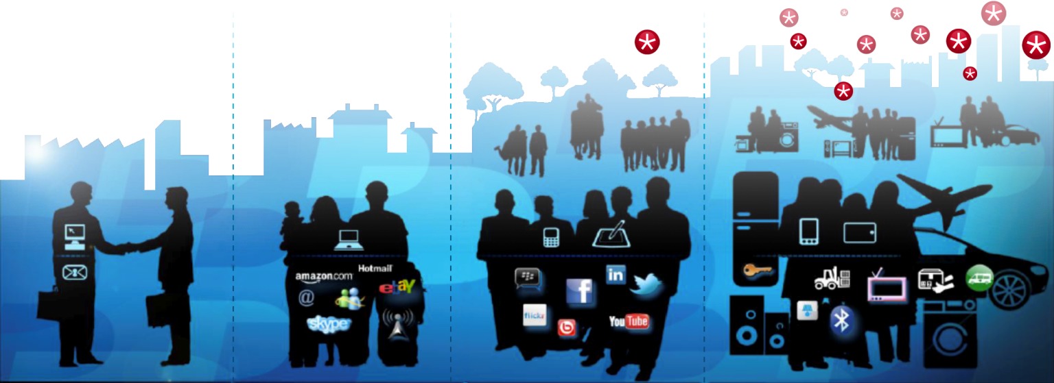
The way the world communicates has changed
Mobile Internet
Community
Content & Commerce
Connectivity
Notes:
The way we communicate has changed since we first launched BlackBerry in 1999.
When we introduced BlackBerry in 1999 we freed people from their desks by allowing them to take email on their hip anywhere they went. This heightened level responsiveness gave our users an edge.
Over the years, this promise of enabling real time communication has evolved to reflect the growing influence of content, commerce and social communities on the way people communicate.
But now, we see the world on the cusp of a seismic shift in terms of how people engage in conversations. Conversations are happening faster, in more places and through more mediums than ever before. Never have conversations been more proliferated, more fragmented or more dynamic.
In this new world of communications in the mobile internet, conversations will take place across multiple systems. This goes beyond just smartphones, tablets and PC’s, but in to a myriad of intelligent things like smart TVs, connected cars, home appliances, planes and beyond….
This is the world we’re building BlackBerry 10 for. In this new world, BlackBerry will simply the relationship between people and communications, content and intelligent things.

Slide 8
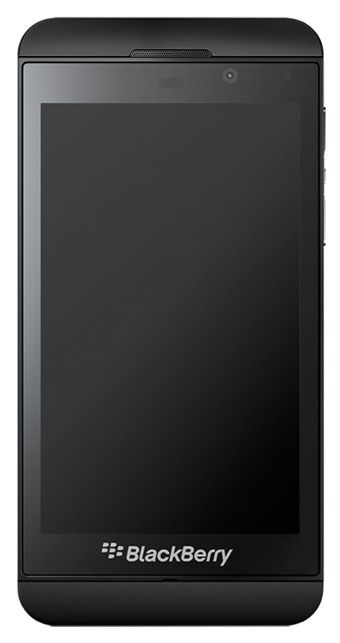
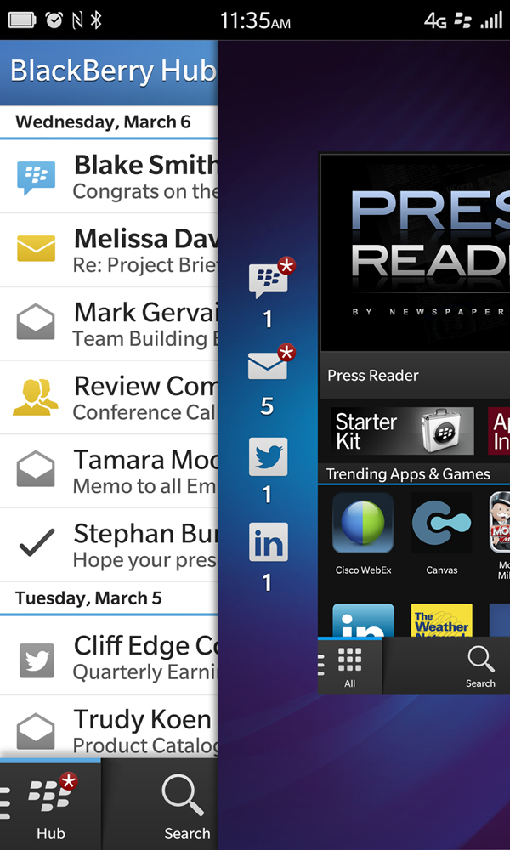
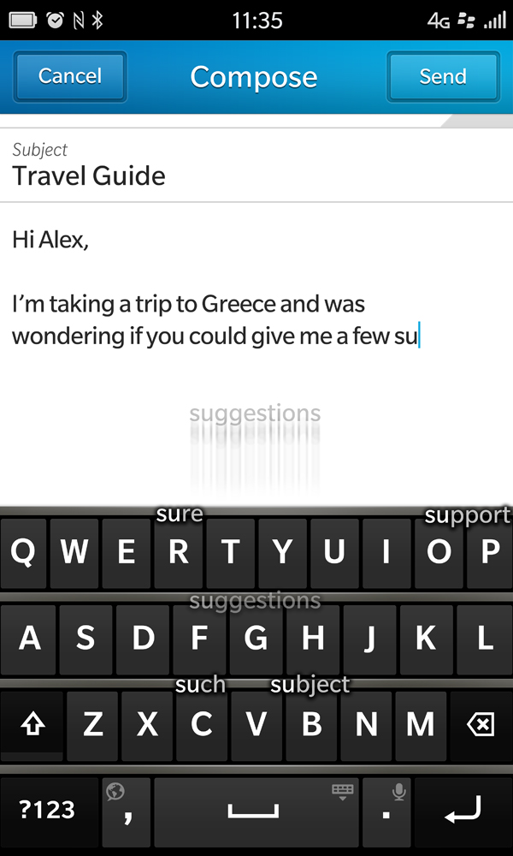
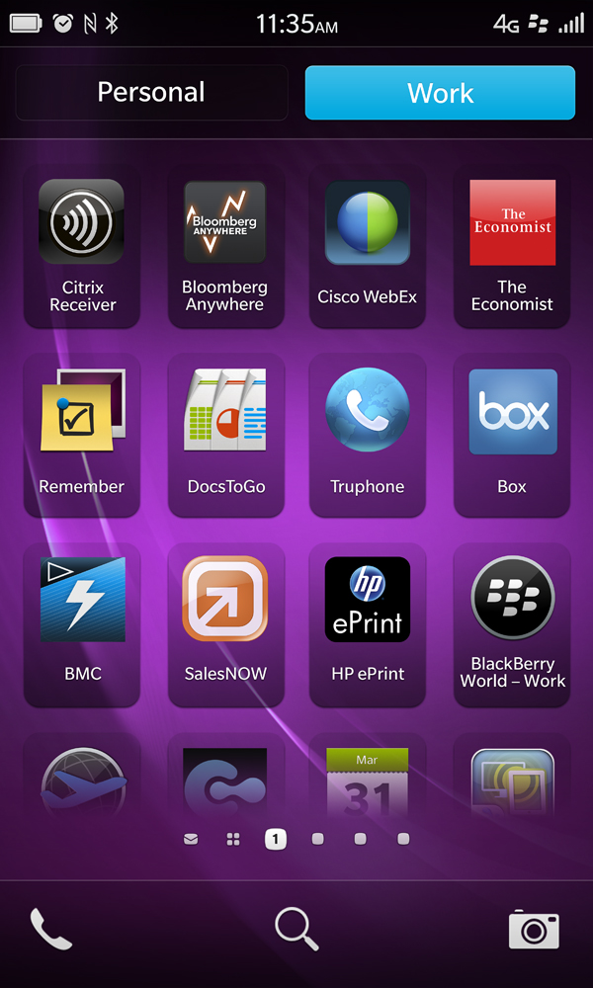
BlackBerry Z10: Built to Keep you Moving
BlackBerry®
Hub
BlackBerry® Keyboard
BBM™ Video with Screen Share
BlackBerry® Balance
“Always one thumb swipe away”
“Best keyboard -
touch or physical”
”Share anything
in an instant”
”Work and life - securely balanced”

Slide 9
Aligning for the future
One Company. One Platform. One Vision.
Notes:
Solid global foundation and assets: Our turnaround starts from a solid platform. Worldwide brand, 80M customers, 2.3 billion in cash and no debt
Engaged in leading our business transformation
New management team
Transition to a new technology platform
BlackBerry 10 will deliver a mobile computing platform that delights consumer and enterprise end users.
Launch goals – establish BlackBerry 10 as the 3rd mobile OS
Our connected ecosystem provides opportunities for all parties
Application Ecosystem – 70K applications at launch, top applications in each category in every launch market.
We will continue to invest in our technology & partnerships that accelerate our vision and value for our partners
We are delivering the entire user ecosystem: BlackBerry 10 connects people and communities, content and services, together with intelligent things.
One Company. One Platform. One Vision.

Slide 10
BlackBerry – Your Partner
Notes:
Strategy:
Be the lowest cost platform for mobile app development
Action:
a) Support multiple open languages for developer to write apps
b) Invest in 3rd party frameworks to accelerate app development
Publish open source libraries to lower app dev costs
Proof Points:
a) 5 open language dev support C++/QT Cascades, html 5 webworks, C/C++ Native, ActionScript Adobe AIR, Java Android Runtime
b) Sencha, jQuery Mobile, Dojo, Marmalade, Shiva3D, Unity, Appcelerator, Kony, Mippin, all committed to platform
c) Massive open source files available at BlackBerry github – 56 separate projects and counting
d) BlackBerry applications are the least expensive to develop, averaging just over $15,000. iOS applications cost 81% more to develop than BlackBerry applications. Because of BlackBerry 10's super open platform approach, it's reasonable to expect that BlackBerry 10 applications will continue to be the least expensive applications to develop.
Strategy:
2. Be the number 1 platform for app revenue generation
Action:
a) Target app developers that want to make money from mobile apps – enterprise and consumer
b) Improve strorefront to sell all content (music, video, games) in addition to mobile apps
c) Increase ease of payment with carrier billing integration
d) Improve app discovery using BBM connected tools and improve discovery techniques
Proof Points:
a) BB is the no.1 platform for revenue generation – generating an average of $3,900 per month – more than iOS, Android or Windows Phone. Most Android and Windows Phone developers live below the "app poverty line" -- that is, they're hobbyists who earn a living from other means.
b) Among enterprise grade developers, BlackBerry outdoes all other platforms, with 10% of developers earning more than $10,000 per month
SOURCE Vision mobile developer economics
c) We believe in our platform monetization so much that we’re committing that each dev submitting a BB10 app will generate $10K revenue – if they don’t we’ll make up the difference
d) BlackBerry App World has more paid downloads per month than the Android Market
(Yankee Research Group)
e) BlackBerry apps generate on average 40% more revenue than Android apps
(Vision Mobile)
f) PlayBook, without carrier billing, is driving 10x times per user revenue over BBOS - good indicator for the monetization strength of BB10
Strategy:
Engage with mobile app developers in an unprecedented way
Action:
a) Worldwide investment in developer outreach via BlackBerry 10 Jam
b) Multi-million dollar investment in web programs, communication tools, online communities and knowledge portals
c) Huge investment in hardware to seed the dev community with tools
Proof Points:
a) $100M investment in developer outreach programs from May 2012 until launch
b) 30 Developer Events worldwide reaching over 5,000 developers in xx number of countries – include DevCon Europe, DevCon Asia, BBW DevJam
c) Number of registered developers or daily hits from x number of countries from around the world
d) $100M investment in developer outreach programs from May 2012 until launch
e) 30,000 PlayBook and Dev Alpha units seeded to developers in x number of countries
f) Any stats on carrier engagement?
Strategy:
4. Ensure coverage of top apps in every category
Action:
Investment in HC in x number of countries to support increased BD activity
Proof Points:
a) On track to deliver 70K apps at launch
b) We’ve grown the number of developers who have registered for BlackBerry App World by 180% from 15,555 to 43,602.
c) We’ve increased the number of apps approved for sale on AppWorld by 130% from 44,108 to 101,441.
d) 12 months ago there were just 3,671 PlayBook apps approved for sale. Today that number stands at a whopping 22,771 PlayBook apps. That’s important because PlayBook Apps can also run on BlackBerry 10, that means we have a great start on building the BlackBerry 10 App catalog as well.
Insert logos of top apps by category committed at launch
Strategy:
5. Deliver unique integrated experiences on BlackBerry 10 with innovative brand partners
Action:
) Target unique app experience that meet the needs of BlackBerry people
Proof Points:
list the partners that agreed to build unique application experiences – facebook, dropbox, Gameloft, LinkedIn, Twitter, Evernote, Salesforce, Cisco
Strategy:
Be the most connected ecosystem to generate value for carrier partners
Action:
Carrier billing
Branded shelf in store
Carrier community outreach?
Proof Points:
Carrier billing stats Available in 50 carriers and growing. Can drive over 70% of App World purchases for an operator
Carrier billing impact on carrier revenue
50 carriers integrated with carrier billing
Where carrier billing implemented:
• 70% of transactions use carrier billing
• 2x to 4x uplift in revenue
• 27% buy 2 items each month
• 32% return to buy the next month

Slide 11
_{4%}
_{More per}
_{App Month Than iOS}
BlackBerry Developers Generate More Revenue
Source: VisionMobile 2012

Slide 12
_{>35%}
_{Per Month Than Android}
BlackBerry Developers Generate More Revenue
Source: VisionMobile 2012

Slide 13
_{21%}
_{More Than Android}
iOS Apps are More Expensive to Develop
Source: VisionMobile 2012

Slide 14
_{81%}
_{More Than BlackBerry}
iOS Apps are More Expensive to Develop
Source: VisionMobile 2012

Slide 15
Open Ecosystem – Developers Decide
C++/Qt Cascades
HTML5 BlackBerry® WebWorks™
C/C++ Native SDK
ActionScript Adobe® AIR®
Java Android™ Runtime
Notes:
Strategy:
Be the lowest cost platform for mobile app development
Action:
a) Support multiple open languages for developer to write apps
b) Invest in 3rd party frameworks to accelerate app development
Publish open source libraries to lower app dev costs
Proof Points:
a) 5 open language dev support C++/QT Cascades, html 5 webworks, C/C++ Native, ActionScript Adobe AIR, Java Android Runtime
b) Sencha, jQuery Mobile, Dojo, Marmalade, Shiva3D, Unity, Appcelerator, Kony, Mippin, all committed to platform
c) Massive open source files available at BlackBerry github – 56 separate projects and counting
d) BlackBerry applications are the least expensive to develop, averaging just over $15,000. iOS applications cost 81% more to develop than BlackBerry applications. Because of BlackBerry 10's super open platform approach, it's reasonable to expect that BlackBerry 10 applications will continue to be the least expensive applications to develop.
Open Source & Open Standards
Open standards are core to the BlackBerry 10 platform and BlackBerry is committed to open source projects – libraries include bbUI, Ripple and BlackBerry WebWorks.
Development Environment Choice
Develop using the environment you want – whether native C / C++, Android, Air or HTML 5 / WebWorks.
Developer Support
Everything needed to design, develop, distribute, market and sell apps on Blackberry 10 – from developer-only devices, to events, code samples and documentation, to distribution, advertising and payment services.

Slide 16
Open Beta Registration!
http://developer.blackberry.com/games

Slide 17
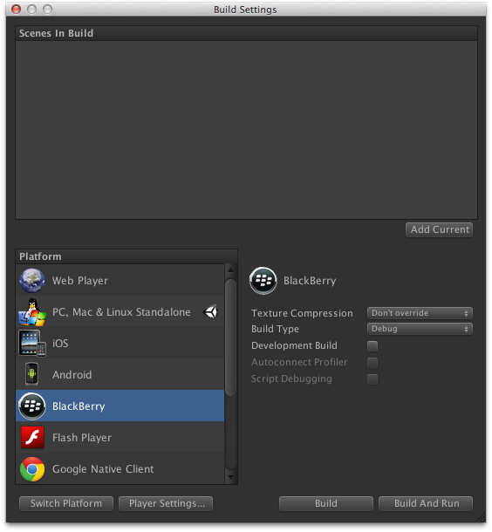
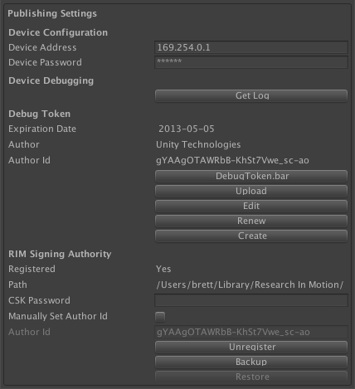
Unity BlackBerry Add-On

Slide 18
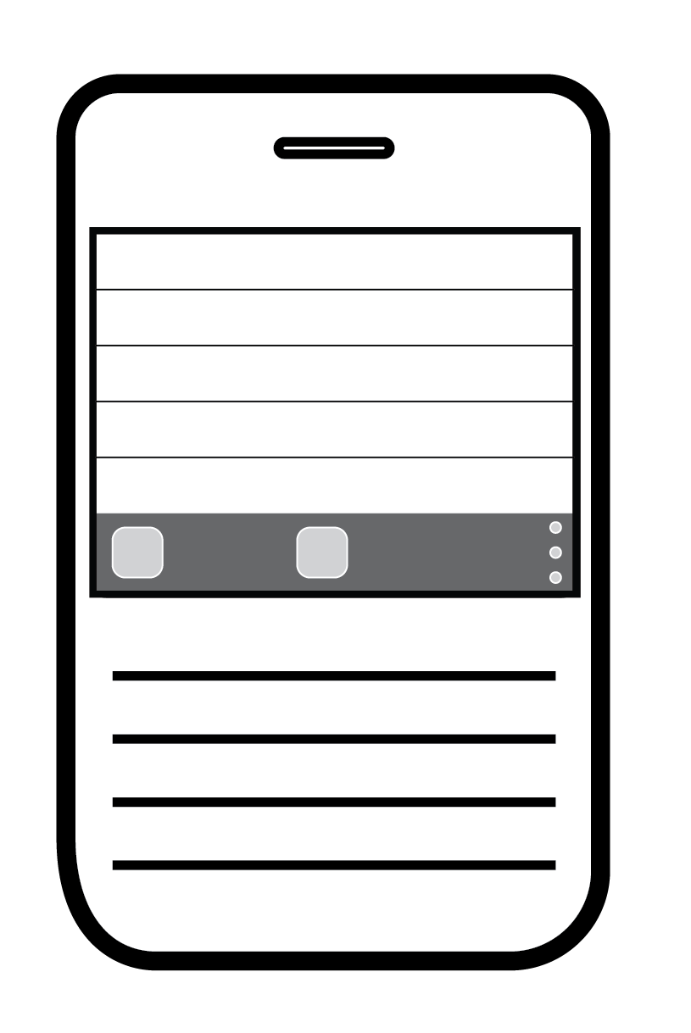
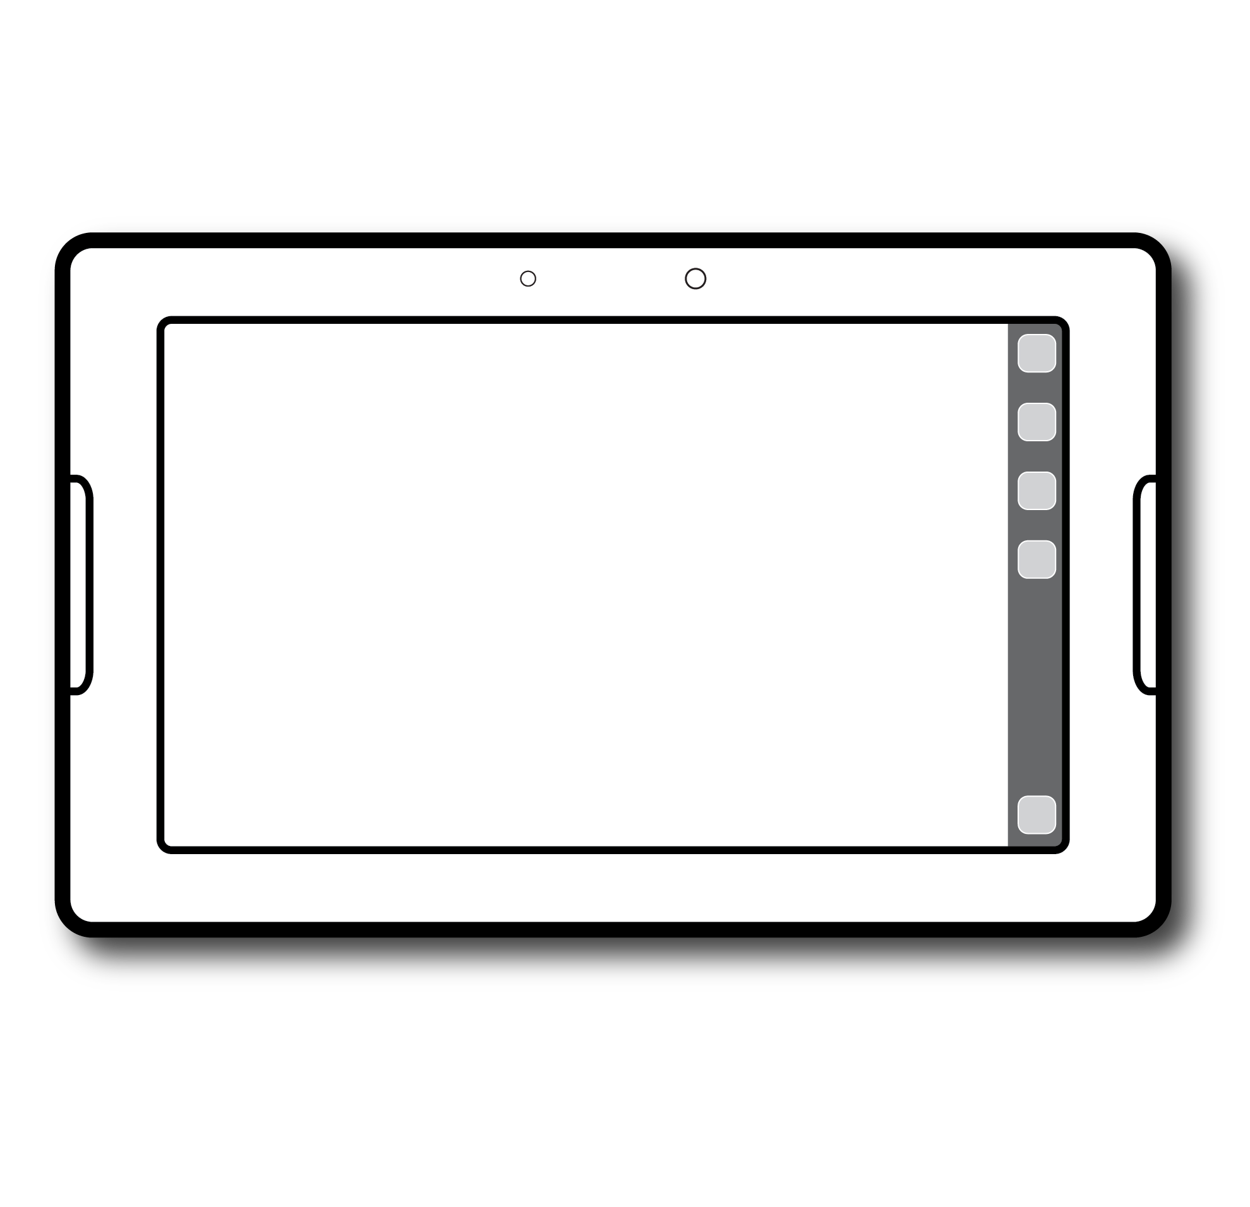
Developing for BlackBerry 10
Screen resolutions
First BlackBerry 10 device will be 1280 x 768 (same as Dev Alpha)
Following devices will standardise on:
All touch devices: 1280 x 720 (16:9)
Qwerty keyboard devices: 720 x 720 (1:1)
Support
Apps developed using core controls and layouts will make the sizing and layout adjustments
User experience guidelines updated to provide layout and interaction considerations
Opportunity
All touch and hybrid offer unique opportunities for UI that will delight the end-user
Notes:
Screen resolutions on BlackBerry 10 easier are now being standardised to make developing less complicated.
BlackBerry now has a complete offering with full touch devices with large screen display and the legendary qwerty keyboard devices for those who prefer the physical experience of communication.

Slide 19
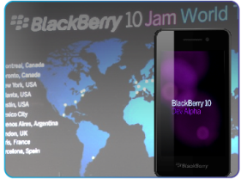
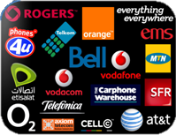
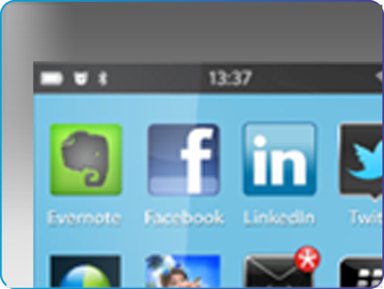
Developer Momentum
Connected Ecosystem
Revenue Generation
Integrated Experience
Developer Engagement
70,000 apps on brand new platform
& 100,000 apps two months from launch
Notes:
Developer Momentum
We’ve grown the number of developers who have registered for BlackBerry App World by 180%
We’ve increased the number of apps approved for sale on AppWorld by 130%
Delivered 70K apps at launch, announcement of hitting 100K mark on 21-Mar!
Strategy: Integrated Experience
5. Deliver unique integrated experiences on BlackBerry 10 with innovative brand partners
Action:
) Target unique app experience that meet the needs of BlackBerry people
Proof Points:
list the partners that agreed to build unique application experiences – facebook, dropbox, Gameloft, LinkedIn, Twitter, Evernote, Salesforce, Cisco
BBM Connected API for discoverability & user delight
Strategy: Connected Ecosystem
Be the most connected ecosystem to generate value for carrier partners
Action:
Carrier billing
Branded shelf in store
Carrier community outreach?
Proof Points:
Carrier billing stats Available in 50 carriers and growing. Can drive over 70% of App World purchases for an operator
Carrier billing impact on carrier revenue
50 carriers integrated with carrier billing
Where carrier billing implemented:
• 70% of transactions use carrier billing
• 2x to 4x uplift in revenue
• 27% buy 2 items each month
• 32% return to buy the next month
Strategy: Revenue Generation
2. Be the number 1 platform for app revenue generation
Action:
a) Target app developers that want to make money from mobile apps – enterprise and consumer
b) Improve strorefront to sell all content (music, video, games) in addition to mobile apps
c) Increase ease of payment with carrier billing integration
d) Improve app discovery using BBM connected tools and improve discovery techniques
Proof Points:
a) BB is the no.1 platform for revenue generation – generating an average of $3,900 per month – more than iOS, Android or Windows Phone. Most Android and Windows Phone developers live below the "app poverty line" -- that is, they're hobbyists who earn a living from other means.
b) Among enterprise grade developers, BlackBerry outdoes all other platforms, with 10% of developers earning more than $10,000 per month
SOURCE Vision mobile developer economics
c) We believe in our platform monetization so much that we’re committing that each dev submitting a BB10 app will generate $10K revenue – if they don’t we’ll make up the difference
d) BlackBerry App World has more paid downloads per month than the Android Market
(Yankee Research Group)
e) BlackBerry apps generate on average 40% more revenue than Android apps
(Vision Mobile)
f) PlayBook, without carrier billing, is driving 10x times per user revenue over BBOS - good indicator for the monetization strength of BB10
Strategy: Developer Engagement
Engage with mobile app developers in an unprecedented way
Action:
a) Worldwide investment in developer outreach via BlackBerry 10 Jam
b) Multi-million dollar investment in web programs, communication tools, online communities and knowledge portals
c) Huge investment in hardware to seed the dev community with tools
Proof Points:
a) $100M investment in developer outreach programs from May 2012 until launch
b) 30 Developer Events worldwide reaching over 5,000 developers in xx number of countries – include DevCon Europe, DevCon Asia, BBW DevJam
c) Number of registered developers or daily hits from x number of countries from around the world
d) $100M investment in developer outreach programs from May 2012 until launch
e) 30,000 PlayBook and Dev Alpha units seeded to developers in x number of countries
f) Any stats on carrier engagement?

Slide 20
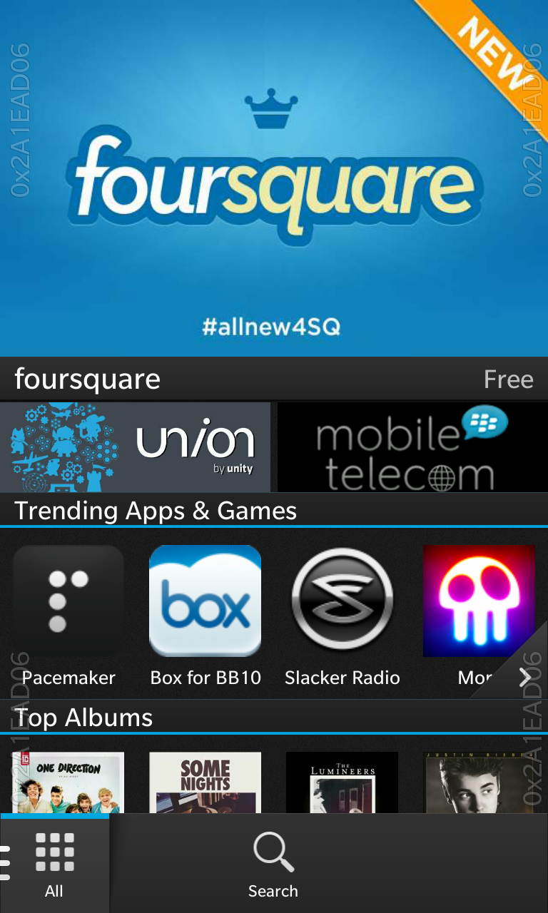
On BlackBerry 10
Feature Banner
BlackBerry World
Grouped Banner
Will be the primary discovery vehicle for Applications on BB10
With BB10 peak and flow functionality App World will be a swipe away from the home screen
Your app can be featured in Blackberry World and displayed in Grouped Banner
Notes:
We want to help you connect with your audience

Slide 21
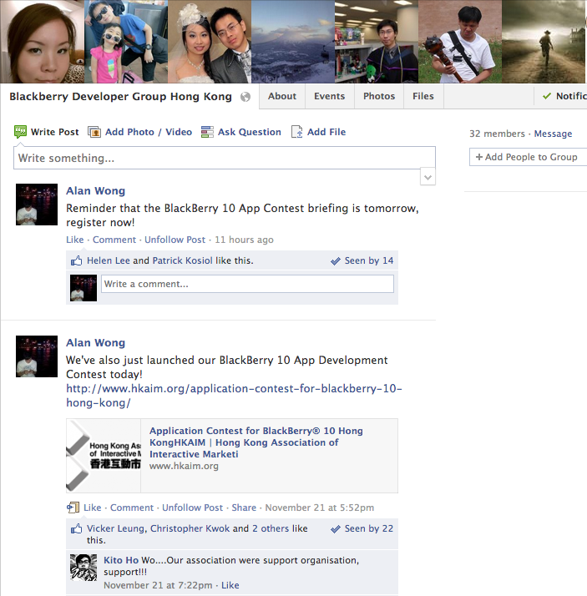
https://www.facebook.com/groups/bbdevhk/

Slide 23
THANK YOU!

